Slide 1


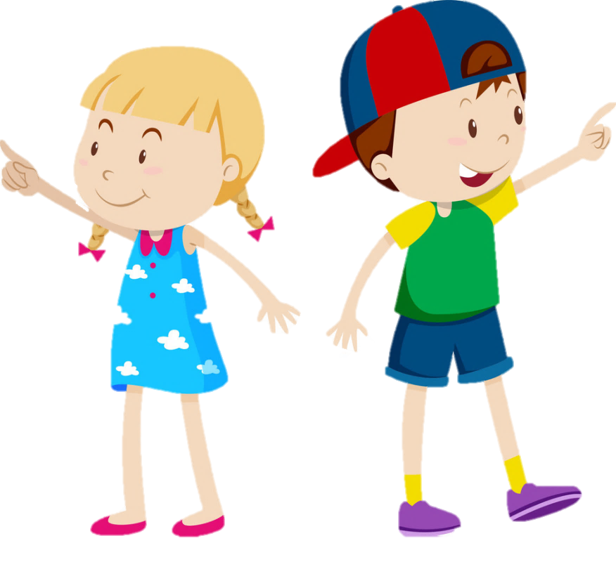
My Favourite Books
By Jahanvi B

Slide 2
My Favourite Books
We all love to read books. Today I am going to tell you some of my favourite books.
The Mahabharata By-Samhita Arni
The Why Why girl By- Mahasweta Devi
Granny’s Sari By- Asha Nehemiah
Moin and the Monster By- Anushka Ravishankar
Padma goes to Space By- Shweta Prakash
We the children of India By- Leila Seth
Handmade in India By-Olivia Frasker
Malgudi Days By- R.K. Narayan
Your Turn Now By- Rushabh Turakhia
Why are you afraid to hold my hand By- Sheila Dhir

Slide 3
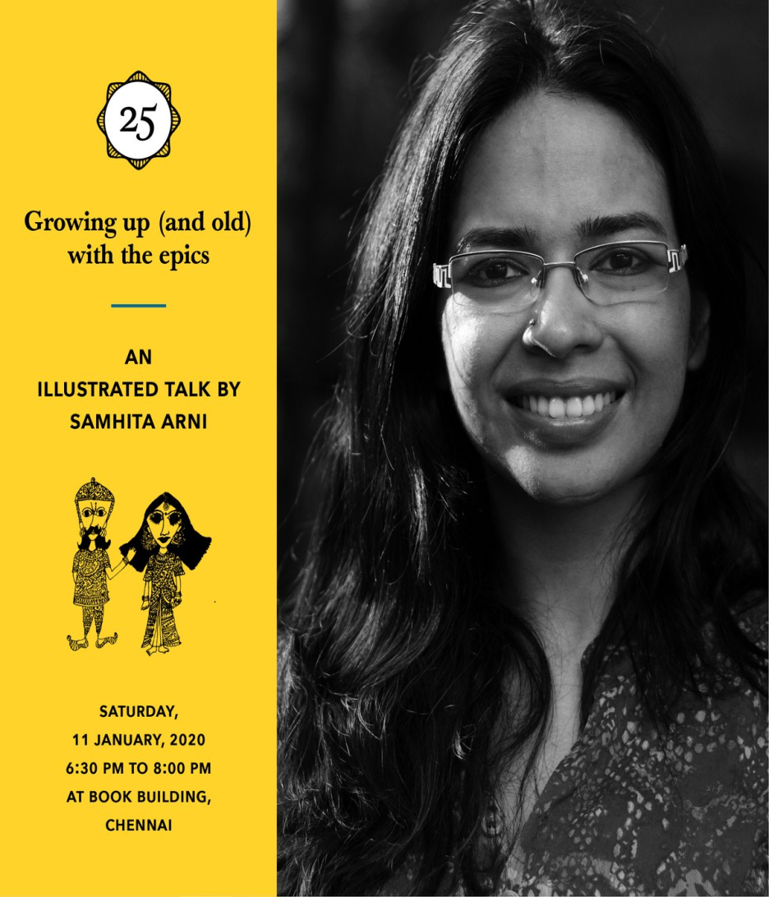
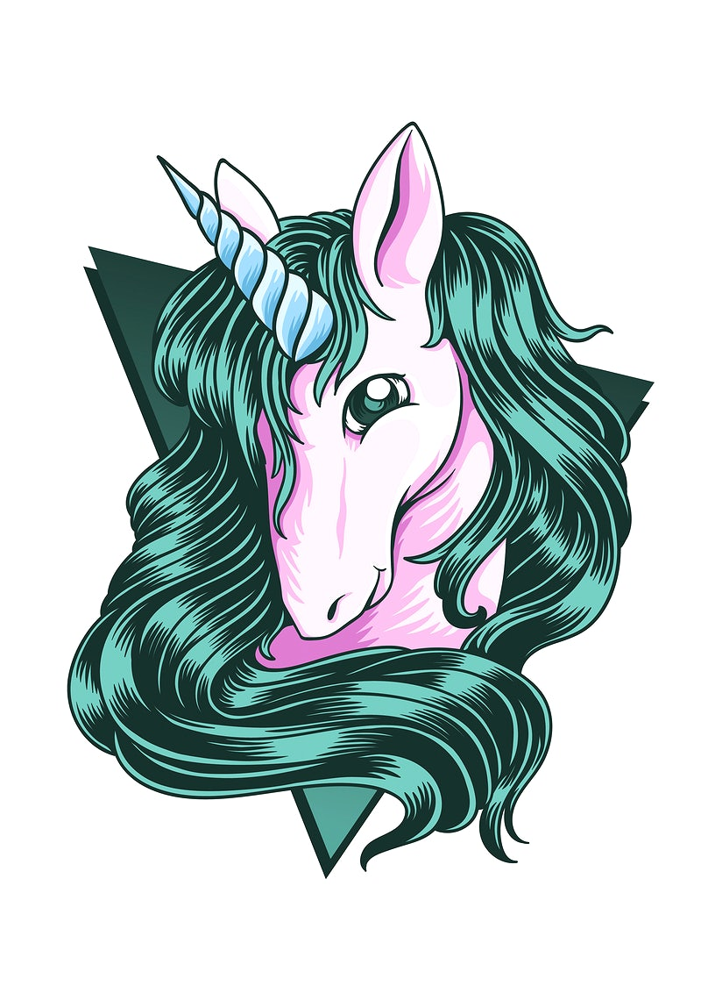
The Mahabharata
Samhita Arni’s “The Mahabharata-A child’s view", published by Tara Books, tells the loved ancient tale of war, kingship, honour and revenge in an unorthodox manner-through the eyed of a child.

Slide 4

The Why Why Girl
Mahasweta Devi tells us how she meets Moyna (and her mongoose!) and this helps her find answers to all the “why- whys” through books that books Moyna learns to read.

Slide 5
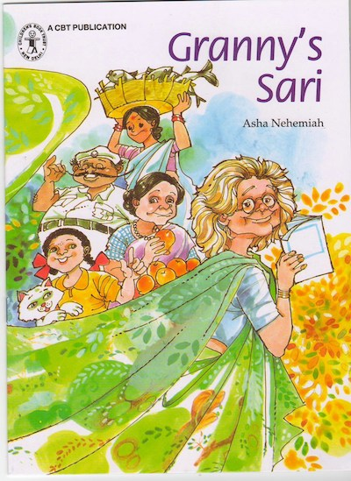
Granny’s Sari
In Asha Nehemiah's book, Granny’s favourite Sari has been blown away b the wind! As Granny and Anu go looking for it, they meet several people who have used the saree to their advantage.

Slide 6
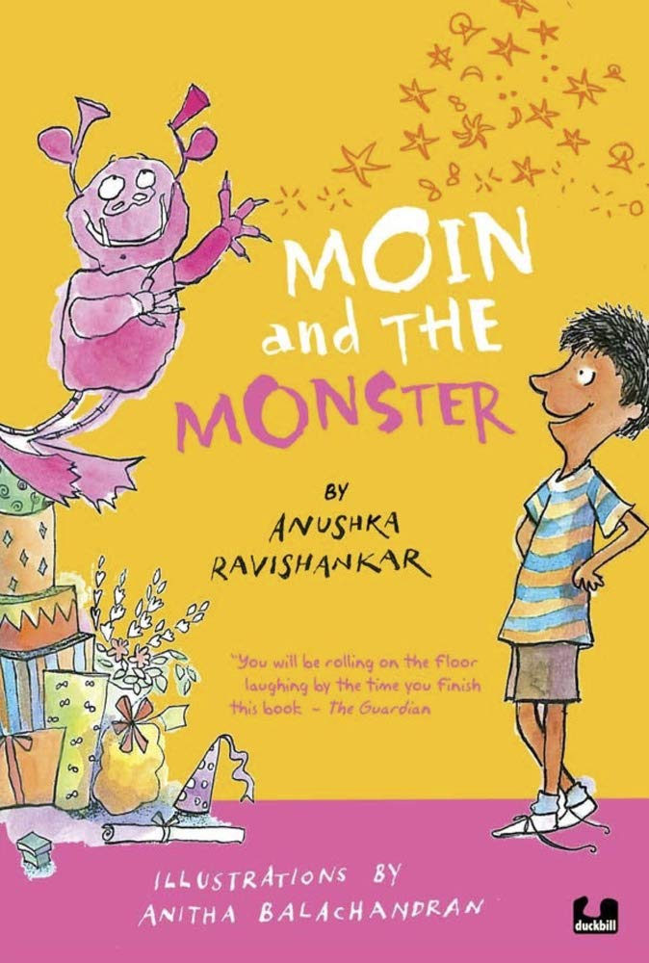
Moin and the MONSTER
Following one of the monster rules- Rule 17- ‘A monster can be sent to human world’- An invisible monster enters Moin’s life. Anushka Ravishankar blends the story perfectly.

Slide 7
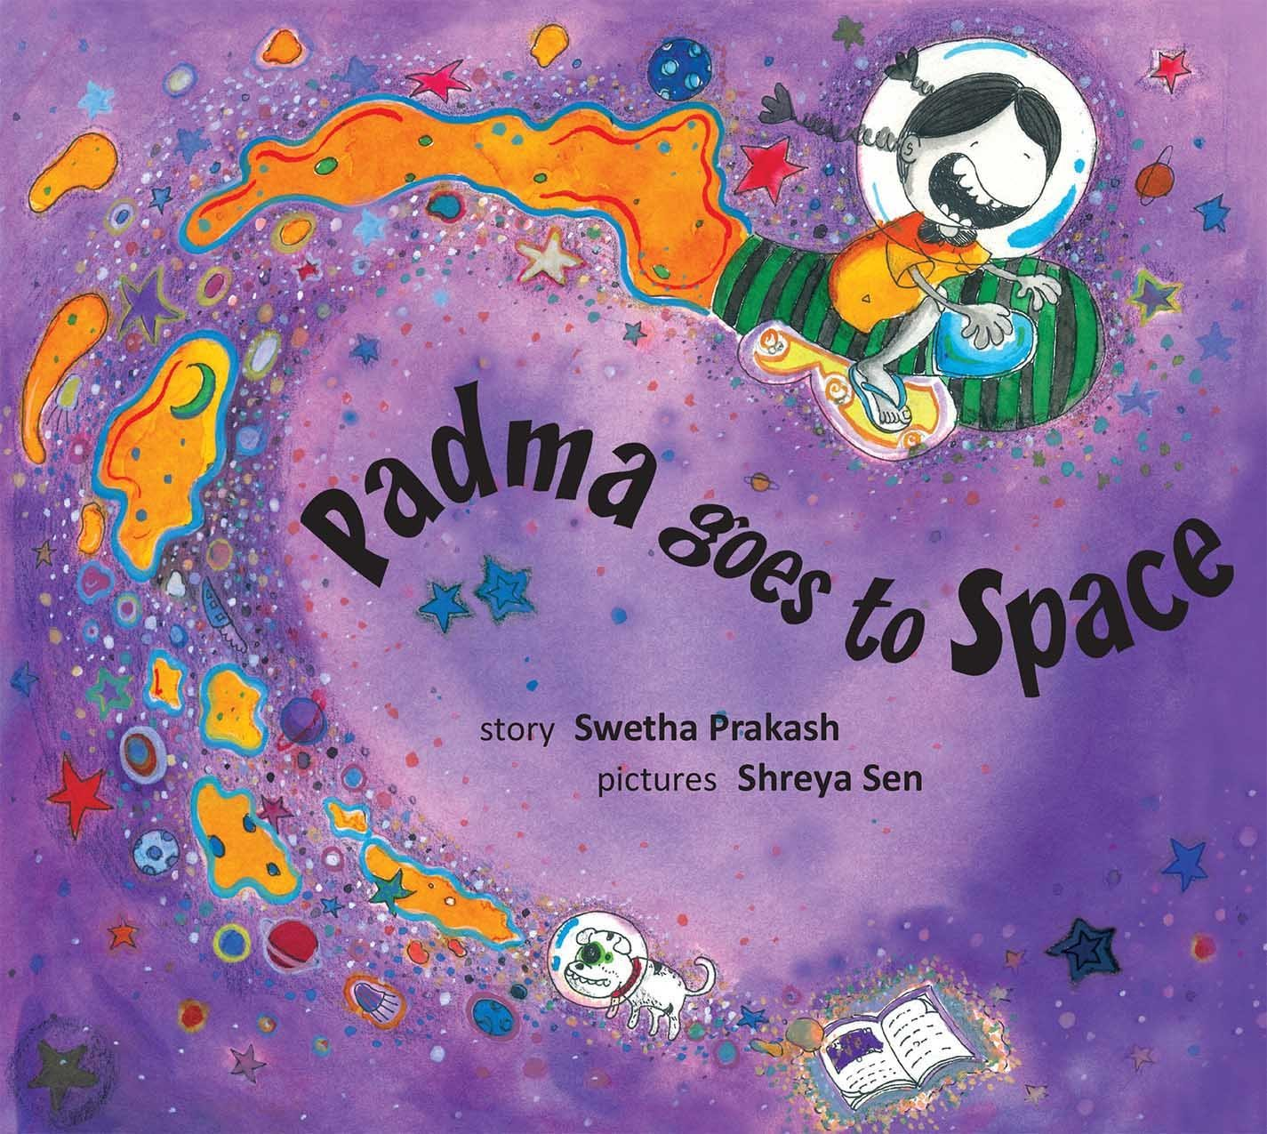
Padma goes to Space
Shweta Prakash tells the story that somewhere in the universe, little children in butterfly shaped time machines eat scrumptious star- rock salad from Galaxy Stellar 5689, and a volcano erupts fruit juice that freezes into ice cream.

Slide 8

We the Children of India
Former Chief Justice Leila Seth makes the words of the Preamble to the Constitution understandable to even the youngest reader.

Slide 9
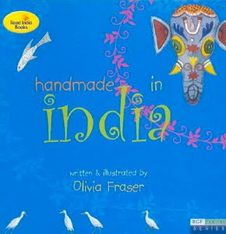
Handmade in India
Olivia Fraser takes us on a delightful journey around the various states of the country and gives us a glimpse of some of the many things that are handmade in India.

Slide 10

Malgudi Days
R.K. Narayan’s classic collection of 32 stories tells the adventures of Swami and his friends in the imaginary town of Malgudi.

Slide 11
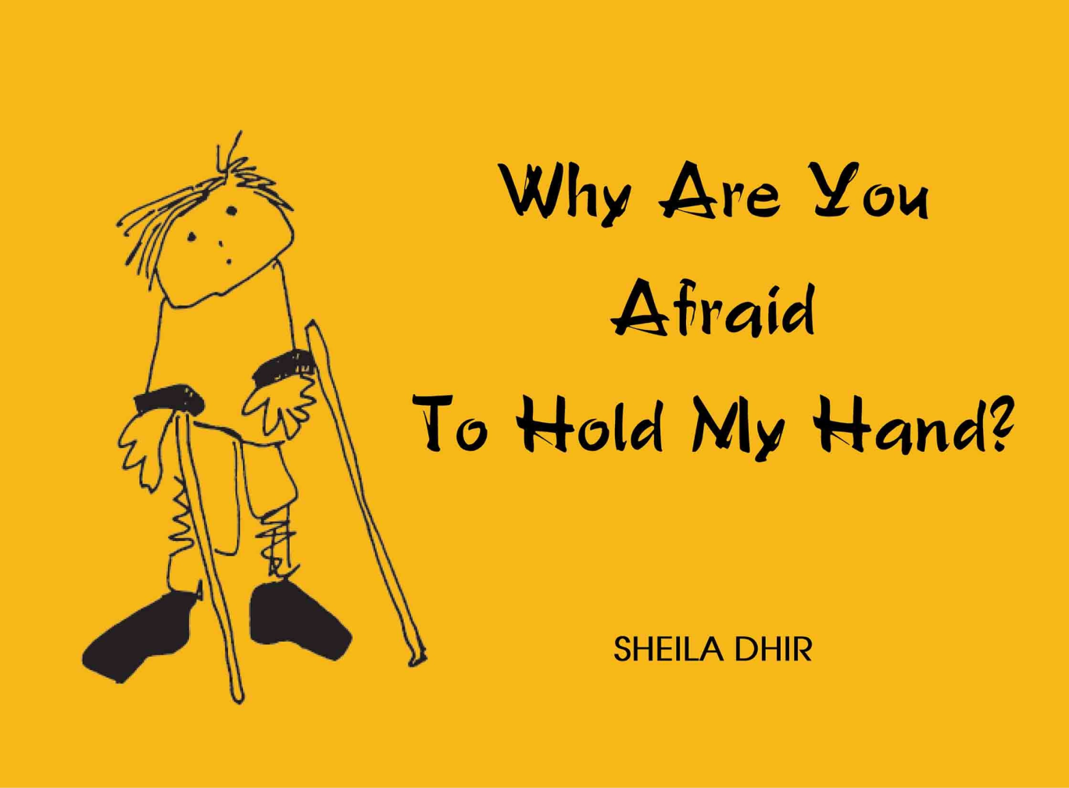
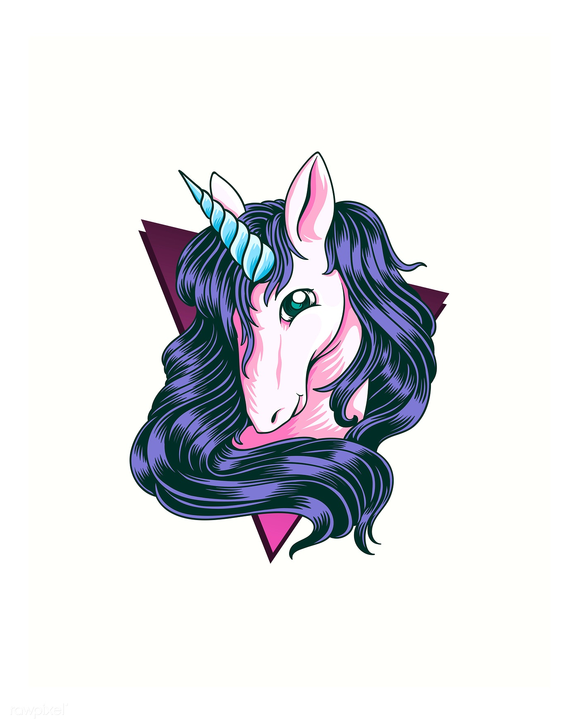
Why are you afraid to hold my hand
Inspired by the Spastics Society of India, this little book by Sheila Dhir is a celebration of the normalcy of the differently-abled.

Slide 12

Your turn now!
‘Your Turn Now’ is a movement started by Rushabh Turakhia with a simple concept- to remind children and adults to use their innate kindness.

Slide 13


